Slide 1
A BRIEF INTRODUCTION TO
AGORA SPEAKERS INTERNATIONAL

Slide 2
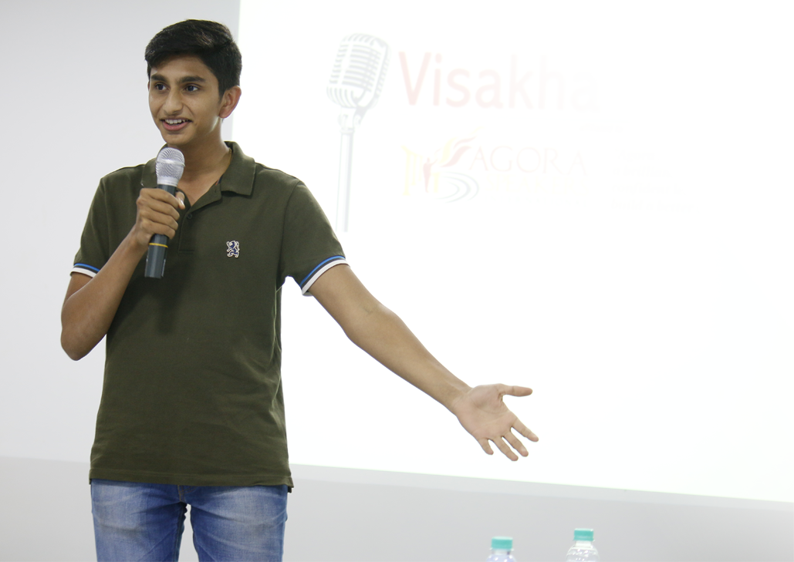
OUR PURPOSE
Agora Speakers International is a worldwide, nonprofit, Public Interest Foundation of passionate volunteers devoted to helping people develop their public speaking, communication, critical thinking, debating and leadership skills.
Our legal registration info is available here.
OUR MISSION STATEMENT
“We empower you to become a brilliant communicator and a confident leader who will actively build a better world”

Slide 3
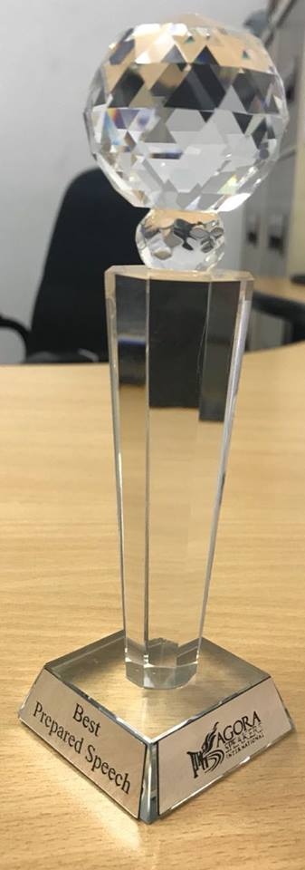
WHAT WE OFFER OUR MEMBERS
✔ Learn Public Speaking and Leadership skills. ✔ Learn to communicate more effectively. ✔ Learn to deliver great presentations in all sorts of contexts.
✔ Join a worldwide community spanning over 50 countries.
✔ International exposure through contests and participation in other clubs.
✔ Improve their foreign language skills. ✔ Sharpen their critical thinking and debating skills. ✔ Increase their self-confidence and ability to defend their interests. ✔ Learn to move people to action, to lead small and big teams. ✔ Defend their viewpoints and principles. ✔ Network with like-minded professionals. ✔ Lead projects with a lasting impact in the real world

Slide 4
OUR TRAINING PROGRAM
Leadership
Public Speaking
Critical Thinking
Debating

Slide 5
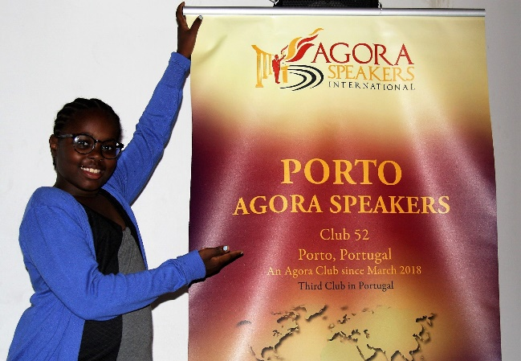
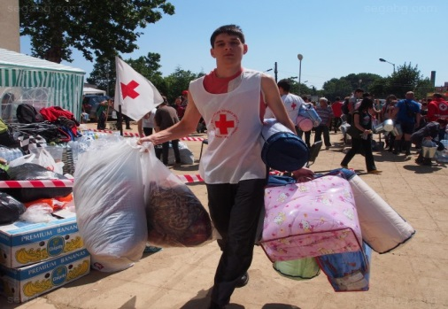
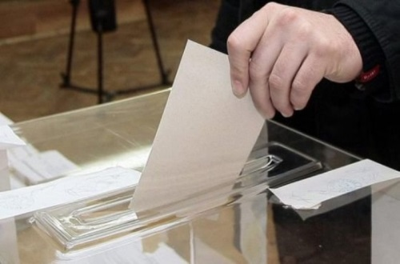
WHY IS THIS IMPORTANT?
…empower people to pursue their professional and personal dreams.
The skills we teach...
…create leaders that have a real positive impact in their surroundings.
…create more informed citizens that cannot be easily manipulated, resulting in a stronger and healthier society.

Slide 6
HOW MUCH DOES IT COST?
For open public clubs, membership is completely free. All educational materials are also available for free online to members. There are no hidden costs and no mandatory purchases.

Slide 7
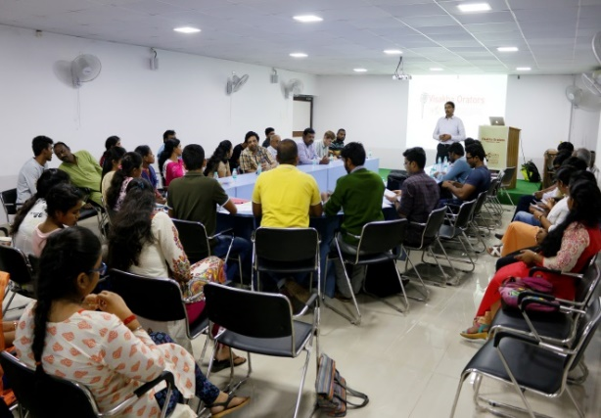
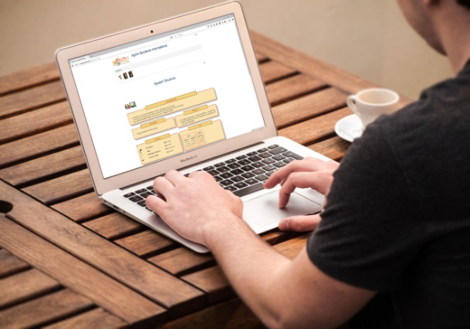
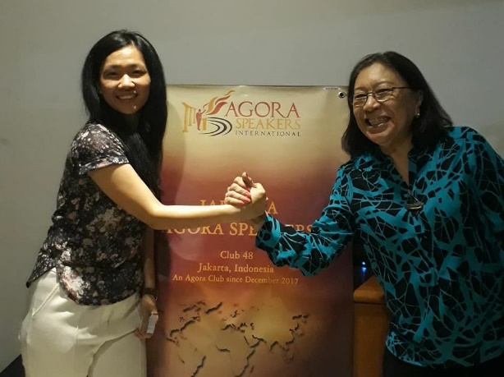
HOW DOES IT WORK?
Our system uses several main elements:
LOCAL CLUBS
EDUCATIONAL PROGRAM
WORLDWIDE COMMUNITY
MENTORS

Slide 8
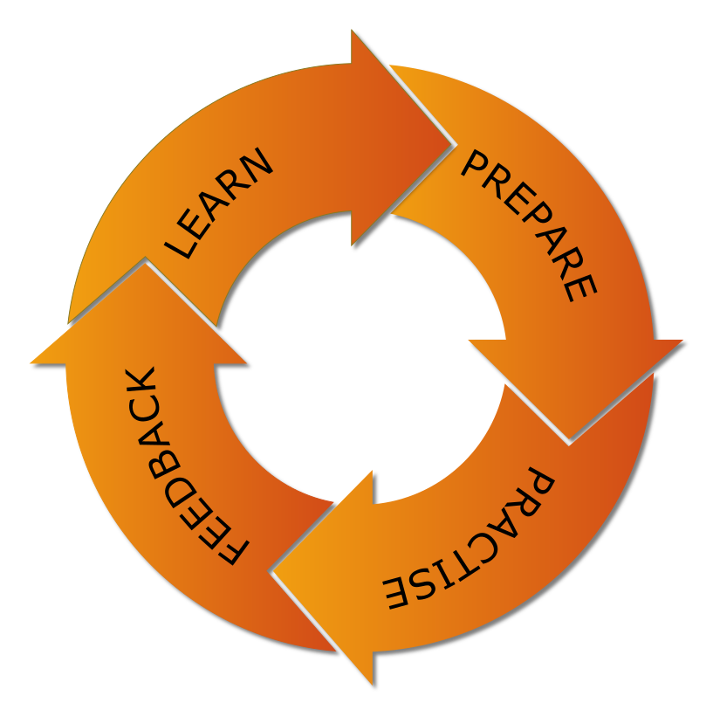
HOW DOES IT WORK?
The way members learn and improve is by studying our training materials, practicing within clubs and receiving peer feedback.
Agora club meetings are not "training sessions" or "seminars". In an Agora Speakers club, there are no "experts" or "teachers“.

Slide 9
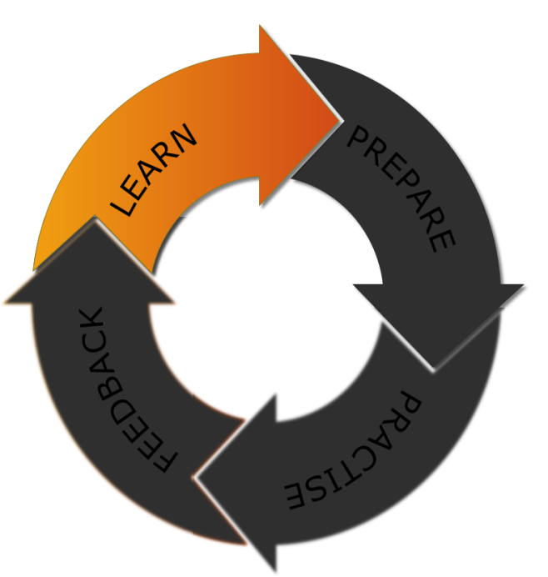
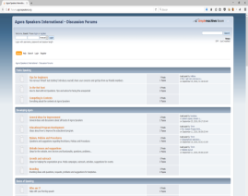
HOW DOES IT WORK?
Study the online materials and resources for each project.
Ask questions and get advice from our worldwide community.

Slide 10
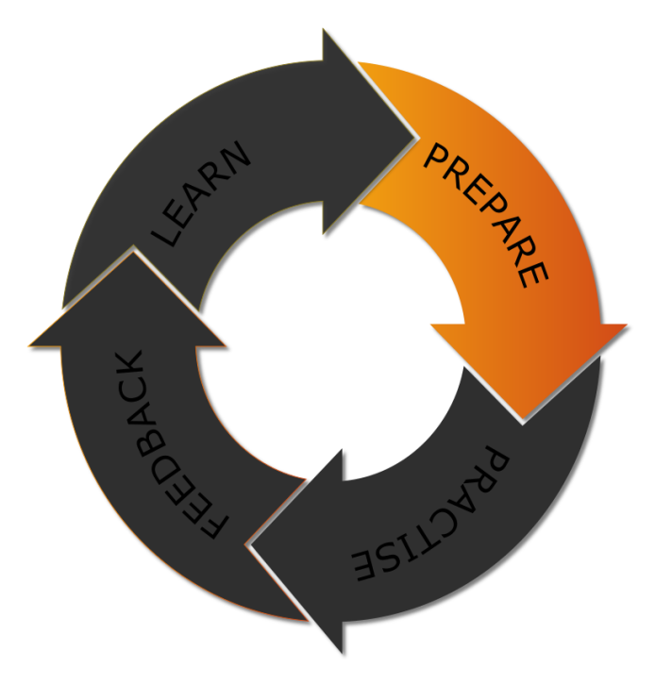
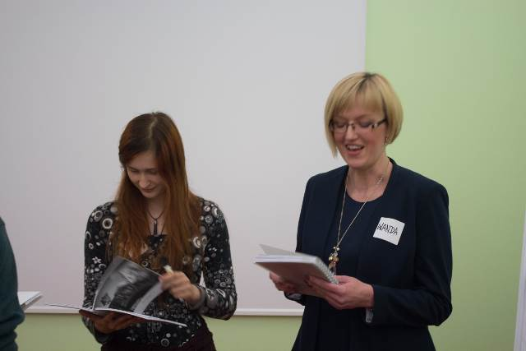
HOW DOES IT WORK?
Prepare speeches and leadership tasks according to project goals.
Discuss and receive guidance from your mentor.

Slide 11
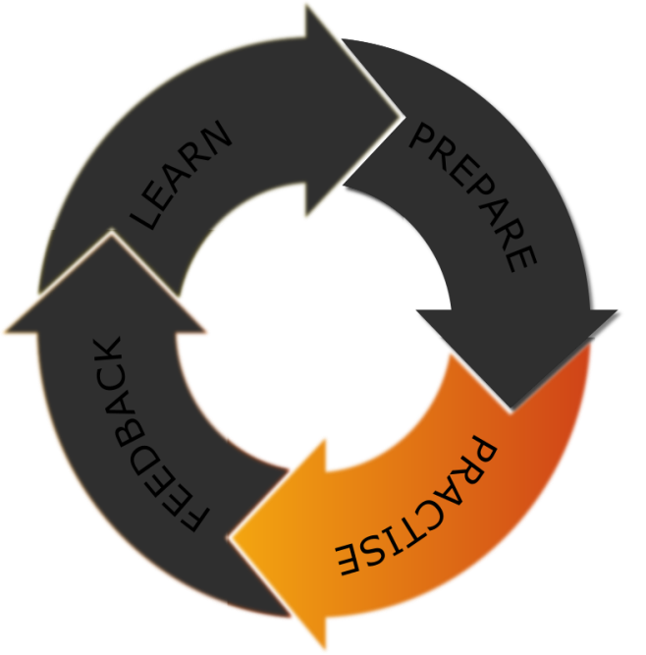
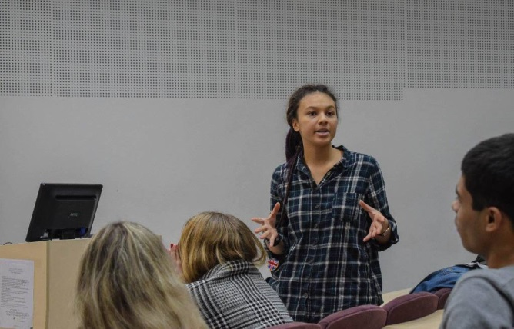
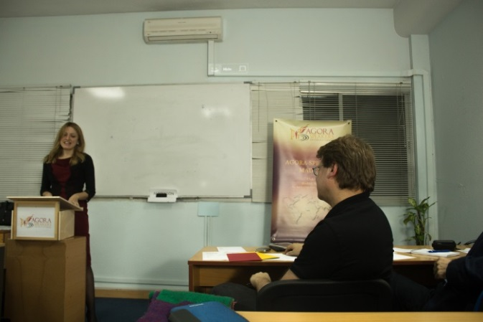
HOW DOES IT WORK?
Deliver prepared speeches in your local club.
Practise leadership and improvisational speaking.

Slide 12
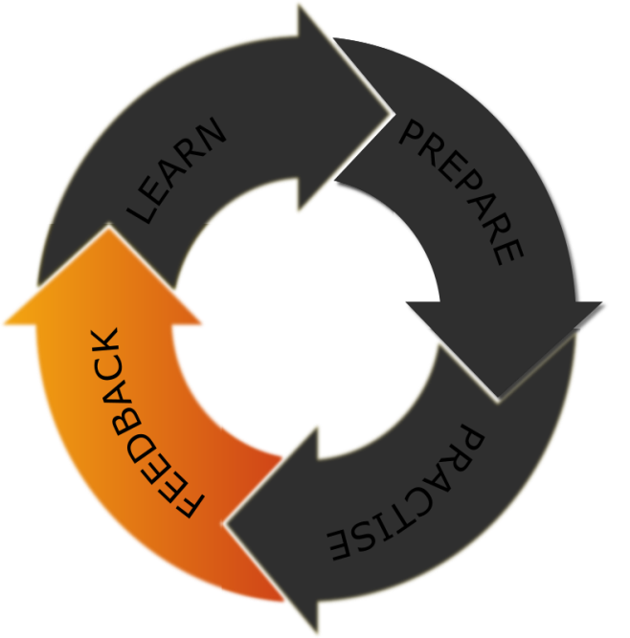
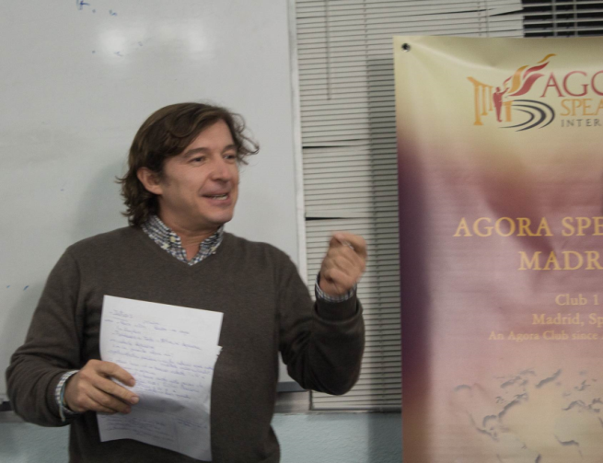
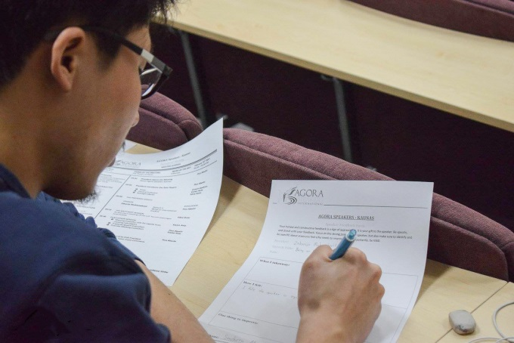
HOW DOES IT WORK?
Receive detailed evaluation from your peers
Receive written feedback from other club members

Slide 13
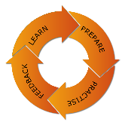
HOW DOES IT WORK?
Project 1
Project 2
Project 3
…
Educational Path
YOU
CLUB MEETING
CLUB MEETING
CLUB MEETING
CLUB MEETING

Slide 14
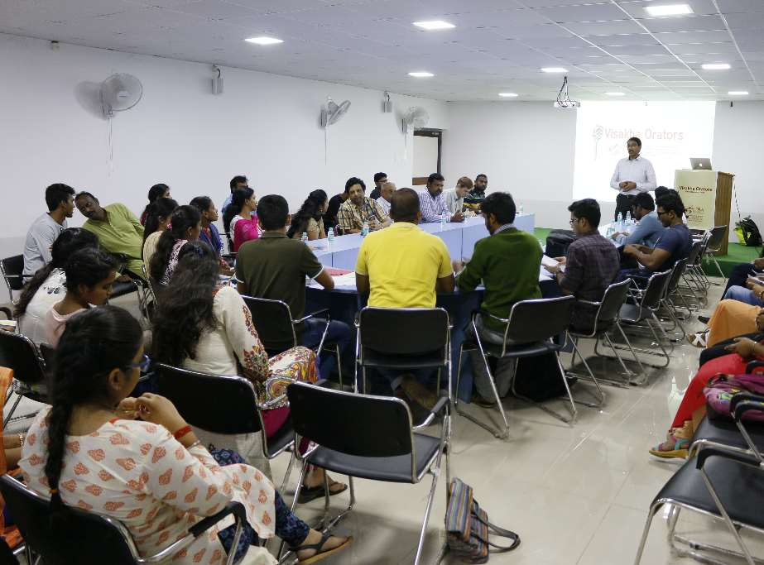
LOCAL CLUBS
Clubs are independent but affiliated with Agora, and are created and run locally by volunteers. Clubs hold regular meetings every week, two weeks or every month.
Clubs provide a place where Agora members meet, learn and practise using the educational program.
Anyone can start a club. The only things needed are time, energy and at least 8 members.

Slide 15
CLUB MEETINGS
TIMER
GRAMMARIAN
SECTION 1
Club meetings proceed following a predetermined agenda with different sections.
People at a meeting take different roles, or they can attend merely as audience.
A timer and grammarian monitor the time and language use in each section.
SECTION 2
MEETING LEADER
SECTION 3
…ETC..

Slide 16
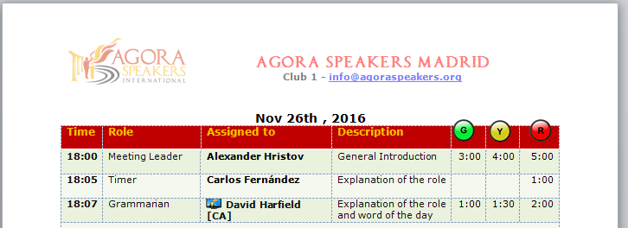
CLUB MEETINGS
Meetings usually last between 1 and 2 hours.
All parts of the meeting are timed, with a minimum and maximum time limit.

Slide 17
CLUB MEETINGS
All meeting sections have an appointed evaluator that provides feedback based on specific educational criteria.
SECTION 1
EVALUATOR
SECTION 2
EVALUATOR
MEETING LEADER
SECTION 3
EVALUATOR
…ETC..
EVALUATOR

Slide 18
SOME MEETING SECTIONS
Prepared Speeches
Speech Evaluation
Analytical Team Reports
Body Language Evaluation
Listening Evaluation
We travel to…
Thinking Critically
Thought of the Day
Goal – Oriented Meetings
Hot Questions
Against All Odds
Speech Analysis
Language Improvement
Ice Breakers
Club Debates
Project of the Month
More details about meeting sections here: https://wiki.agoraspeakers.org/Meeting+Roles

Slide 19
A TYPICAL CLUB MEETING
INITIATION
FOR EACH SECTION
CONCLUSION
MEETING LEADER INTRODUCES THE MEETING
MEETING LEADER INTRODUCES THE SECTION EVALUATOR
MEETING LEADER CALLS THE GRAMMARIAN
MEETING LEADER INTRODUCES THE TIMER
SECTION EVALUATOR TALKS ABOUT THE SECTION
GRAMMARIAN PROVIDES REPORT
TIMER SPEAKS ABOUT HIS ROLE
MEETING LEADER INTRODUCES THE SECTION LEAD
MEETING LEADER CALLS THE TIMER
MEETING LEADER INTRODUCES THE GRAMMARIAN
SECTION LEAD TAKES OVER
TIMER PROVIDES REPORT
GRAMMARIAN SPEAKS ABOUT HIS ROLE
MEETING LEADER GIVES TIME FOR FEEDBACK
MEETING LEADER CALLS THE MEETING EVALUATOR
SECTION EVALUATOR PROVIDES FEEDBACK
MEETING EVALUATOR PROVIDES REPORT
MEETING LEADER ASKS THE GUESTS FOR FEEDBACK

Slide 20
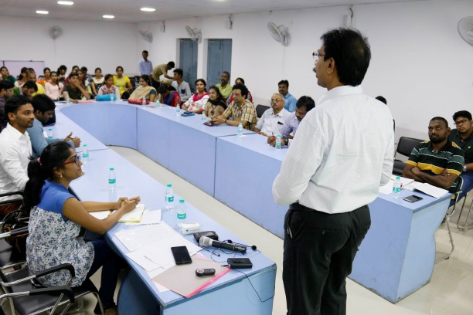
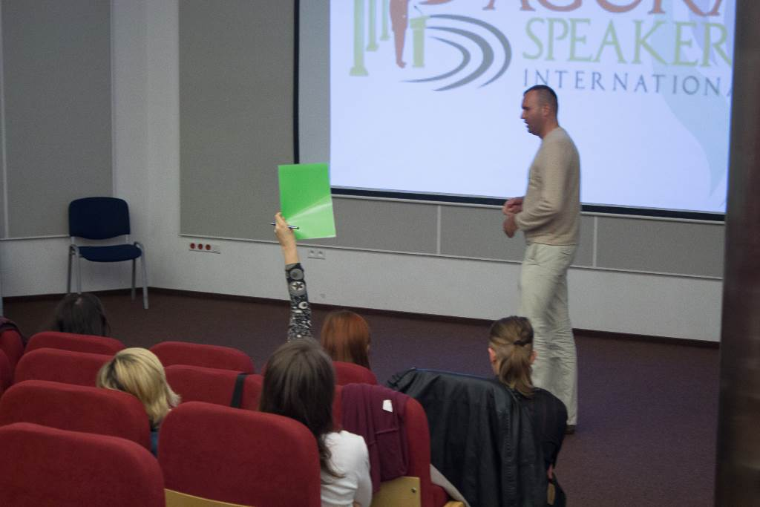
SOME MEETING ACTIVITIES AND ROLES
MEETING LEADER
The Meeting Leader is the person in charge of leading the meeting, giving the floor to each person according to the planned agenda, greeting them on the stage, sending them off and in general ensuring that the meeting flows smoothly
TIMER
The Timer measures and records the timing of all participants, and provides a report at the end. During their participation, he provides them with three visual signals – green, yellow and red – to inform them of how they’re doing with their timing.

Slide 21
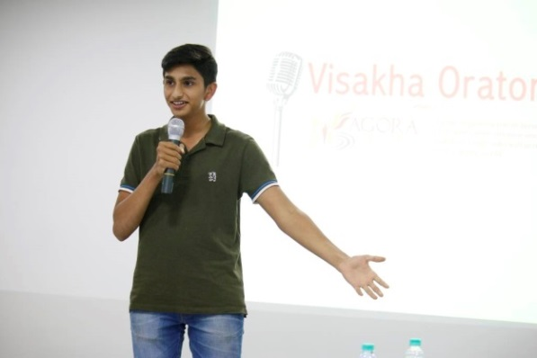
SOME MEETING ACTIVITIES AND ROLES
GRAMMARIAN
The Grammarian watches for language correctness during the meeting, and also provides a report at the end. Usually he also provides a “word of the day” for people to try to use in their speeches.
SPEAKER
The speaker delivers a speech according to the instructions and goals described in the different projects of the Educational Program. Usually in a meeting there are between 1 and 3 speakers, depending on the available time.

Slide 22
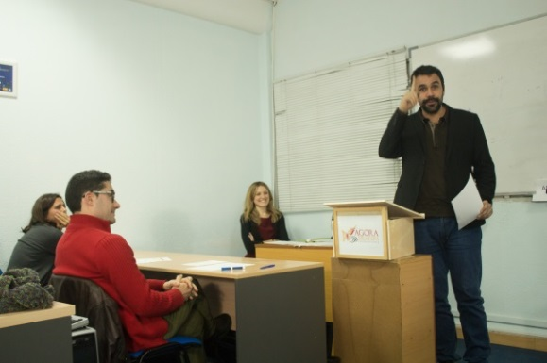
SOME MEETING ACTIVITIES AND ROLES
EVALUATOR
Evaluators provide feedback and comments for improvement to other participants.
HOT QUESTIONS
The Hot Questions section challenges participants with improvising on the spot a 2-3 minute speech based on a question they don’t know in advance. It trains members to think quickly and creatively and to structure their thoughts.

Slide 23
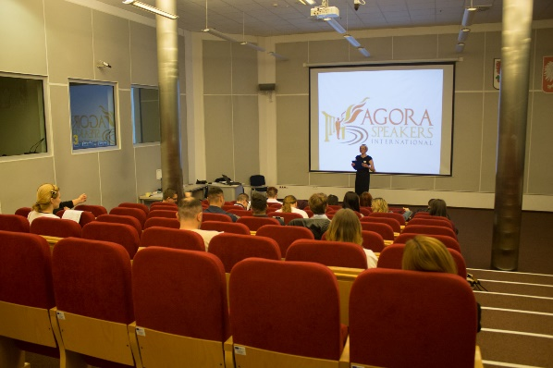
SOME MEETING ACTIVITIES AND ROLES
PROJECT OF THE MONTH
Designed to encourage clubs to commit to specific, small-scale but real community projects outside of their environment. Not necessarily every month, but lasts for a month.
LANGUAGE IMPROVEMENT
For clubs meeting in languages other than their native, the language improvement section features activities designed to improve the language proficiency of the members

Slide 24
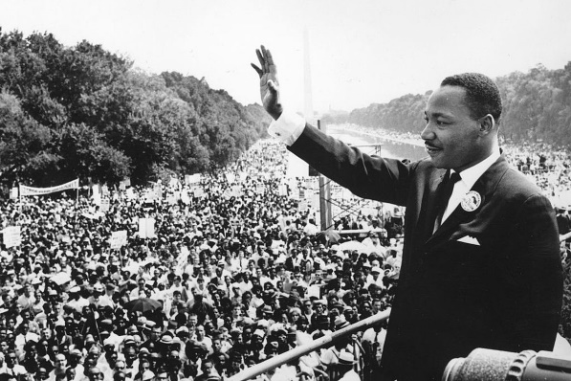
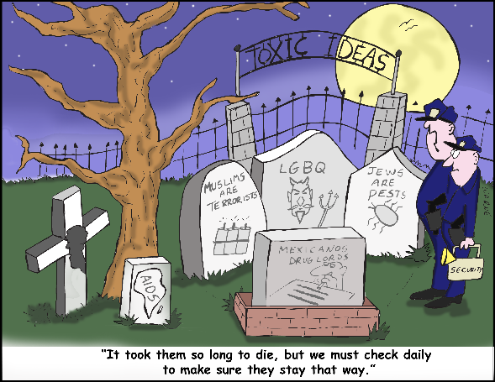
SOME MEETING ACTIVITIES AND ROLES
SPEECH ANALYSIS
Designed to learn from the best Speakers. The Speech Analysis projects require analyzing a speech from a specific viewpoint (e.g.: use of body language, vocal variety, etc..) and presenting the speech and analysis to the club
TODAY WE TRAVEL TO...
Designed to combat dehumanization and stereotyping of collectives. Projects require researching and highlighting a positive aspect of an ostracized collective.

Slide 25
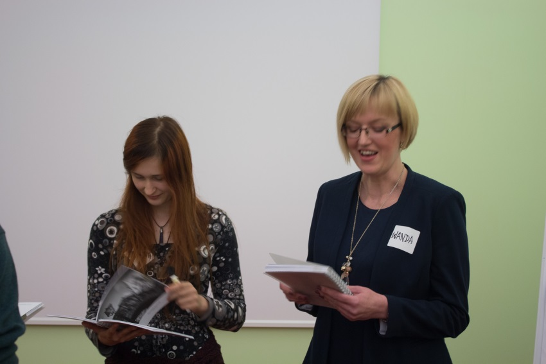
CLUB OFFICERS
Managing a club does require some time and effort in order to have successful meetings.
Each club has a management team of club officers with different responsibilities.
Club officers are volunteers that do not receive economic compensation for their work.
Positions are always elected by club members for a 1 year term and they provide the first step of a leadership training.

Slide 26
CLUB TYPES
Open Public
Restricted
Corporate
Public Interest
Free
Paid

Slide 27
CLUB TYPES
Open Public Clubs - Open to everyone. No requirements for joining other than availability of space. Free.
Public Interest Clubs - Clubs in public institutions (schools, universities, government branches, etc.) with membership limited to students, teachers, employees, etc. Free.
Restricted Clubs - Open to anyone that matches a certain set of requirements. These requirements can be professional, or in terms of experience with the Agora Educational Program. All requirements must be made public, and must be non-discriminatory. Fees apply.
Corporate Clubs - Clubs that are embedded within a business company and meet in its premises. Fees apply.

Slide 28
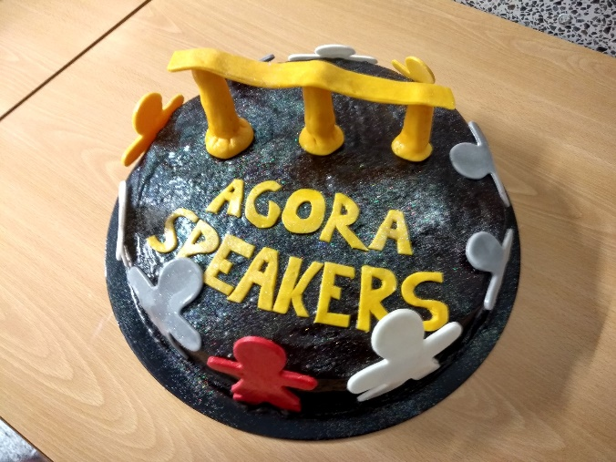
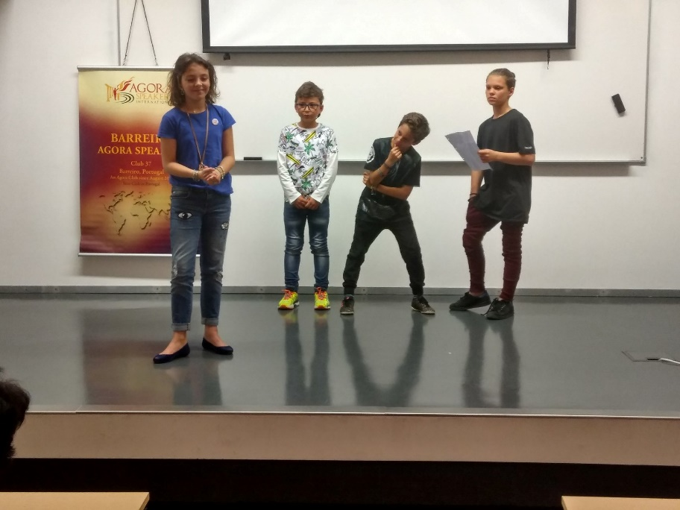
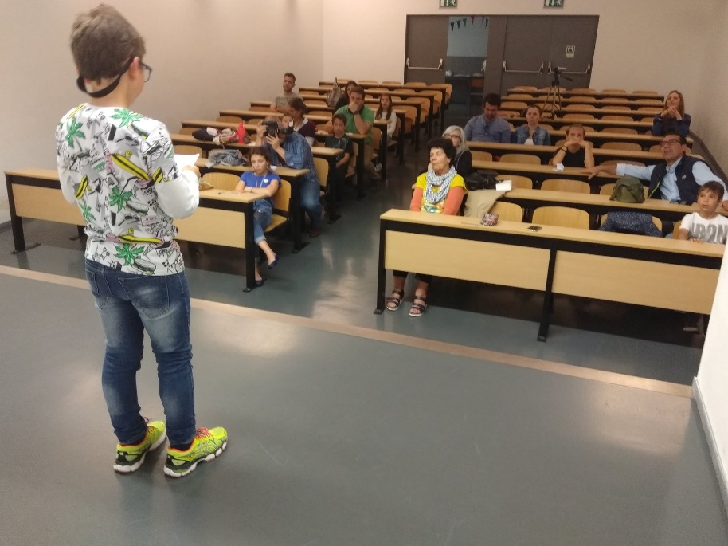
AGORA YOUTH PROGRAM
We regularly hold events for kids, and there are also youth clubs specialized in young members
A special program for children in early-school and pre-school ages is being developed

Slide 29
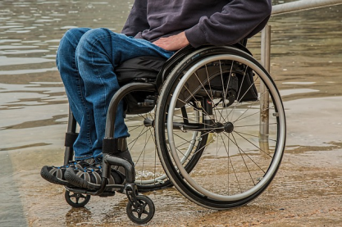
CORE CLUB REQUIREMENTS
NON-DISCRIMINATION
“Clubs may not exclude member candidates on the basis of race, color, religion, sexual orientation, gender identity or expression, age, income level, nationality, ethnicity, or mental or physical disabilities, as long as the member, through his own individual effort, is able to participate in the educational programs of the Association.”
NONPROFIT
“Funds collected by the clubs - regardless of their source - may only be used for the overall operation of the club, and never as an economic benefit for any person.”

Slide 30
CORE CLUB REQUIREMENTS
TOLERANCE
“Members in a club must be supportive, respectful and exercise tolerance with each other, even when the speech subject or opinion expressed by the speaker is one with which most people may deeply disagree.”
NEUTRALITY
“Agora Clubs may not be used to promote any religious or political agenda or worldview, or to promote other associations, companies, services or products, and they may not limit the contents of speeches to match any such agenda or worldview.”

Slide 31
CORE CLUB REQUIREMENTS
INTELLECTUAL HONESTY
“Members in a club must be intellectually honest. Similar to scientific researchers, they should keep an open mind to new ideas, continuously examine critically their viewpoints and beliefs, and be ready to let go of them if new compelling evidence or arguments are presented. They must not engage in manipulation or any kind of deceptive techniques in order to pursue their goals or argue their viewpoints”

Slide 32
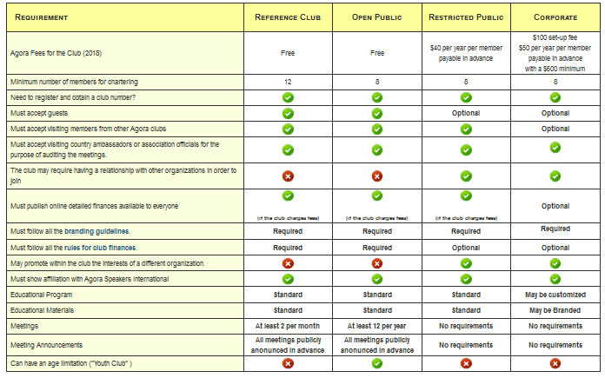
OPERATIONAL CLUB REQUIREMENTS
Clubs need to comply with a series of minimum requirements in terms of meeting frequency, meeting roles, etc. Please check the following page for a detailed listing: http://wiki.agoraspeakers.org/ocr

Slide 33
EDUCATIONAL PROGRAM
The Educational Program is composed of one mandatory Basic Path and many optional Advanced Paths.
Within each path there are different projects.
Each project has a specific learning objective and goals.
The Educational Program is available online for free to all members.

Slide 34
PROJECTS
There are different types of projects.
Most projects involve preparing and presenting a speech in your club, according to specific goals.
Some projects require analyzing a famous speech from a particular viewpoint, and presenting your analysis to the club.
Some projects require doing some in-depth research for a speech.
Some projects require measuring exactly the effect of your presentation.
Some advanced projects require that you leave the comfort zone of your club and deliver speeches or lead people outside of the club environment.

Slide 35
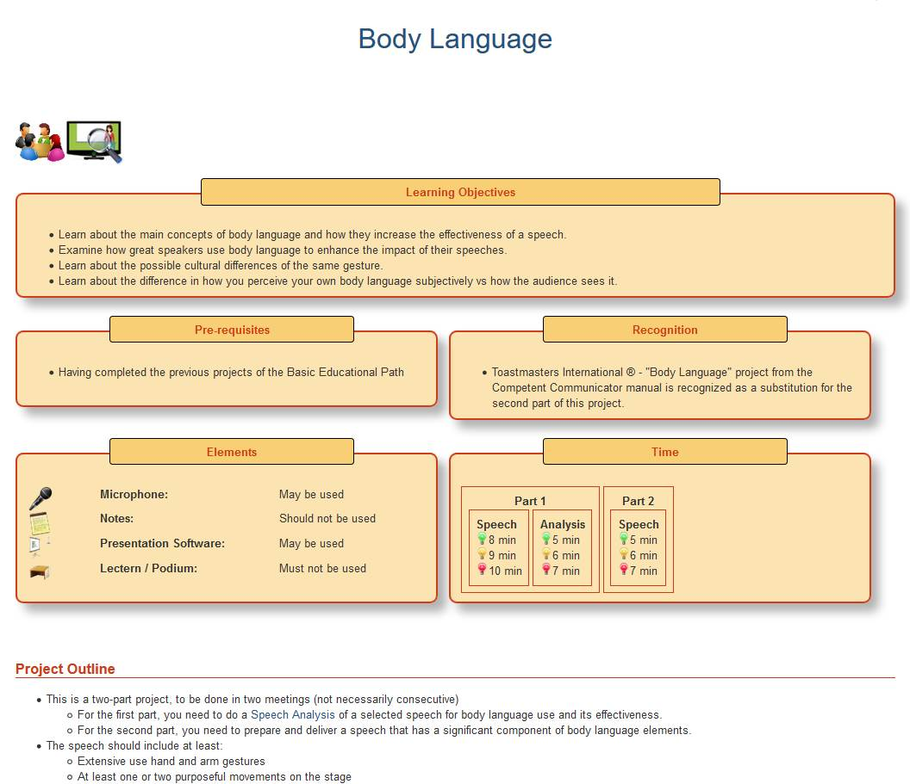
PROJECTS
The documentation of each project is available online.
All projects follow a similar template, detailing goals, timings, what may and may not be used, how to evaluate the project, tips and suggestions, etc.

Slide 36
THE BASIC EDUCATIONAL PATH
The Basic Path is composed of three sections. Each section has a set of projects to be completed in order.
First Projects
Basics of Speaking (applicable to any speech)
Speaking Techniques
(specific techniques applicable to some speeches)
Timer or Filler Words Report
Speaking about the things you like
Who am I?
Speech Structure
Speech Message
Speech Development
Body Language
Researching your Audience
Presentation Software
Inconvenient Allies - Using Microphones
Vocal Variety
Researching a Topic
Using Humor
Using Anecdotes
Using Emotion
Achieving Stage Presence (Charisma)

Slide 37
THE ADVANCED PATHS
Once specific projects from the basic path have been achieved, the participant can “unlock” thematic advanced paths
First Projects
Basics of Speaking
Speaking Techniques
Dramatization - 7
Interpersonal Skills - 7
Storytelling - 10
Speaking in Business Contexts - 11
Persuasive Skills - 9
Speaking for Entrepreneurs - 10
Critical Thinking and Debating - 8
Against All Odds - 7
Educational Speeches - 9
Humorous Speeches - 7
Leadership - 7
Improving Agora - 11

Slide 38
LEARNING MATERIALS
Online Wiki
Downloadable eBooks
Printed Books
Forums
Work Groups

Slide 39
CERTIFICATES
Core Certificates are awarded by Agora Speakers International at the end of each path. Clubs can introduce additional certificates

Slide 40
BADGES
Digital Badges conformant to the Open Badges standard are awarded by Agora Speakers International. They contain digitally signed information embedded in the image that can be verified by employers, interested people, etc.

Slide 41
WORLDWIDE COMMUNITY
Agora Speakers International is headquartered in Madrid, Spain.
We're present in over 70 countries with 120 local clubs, and constantly expanding.
The worldwide community provides tremendous value in terms of networking and participation opportunities.

Slide 42
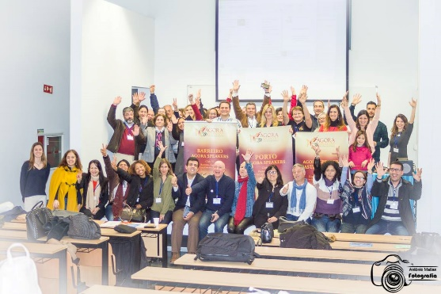
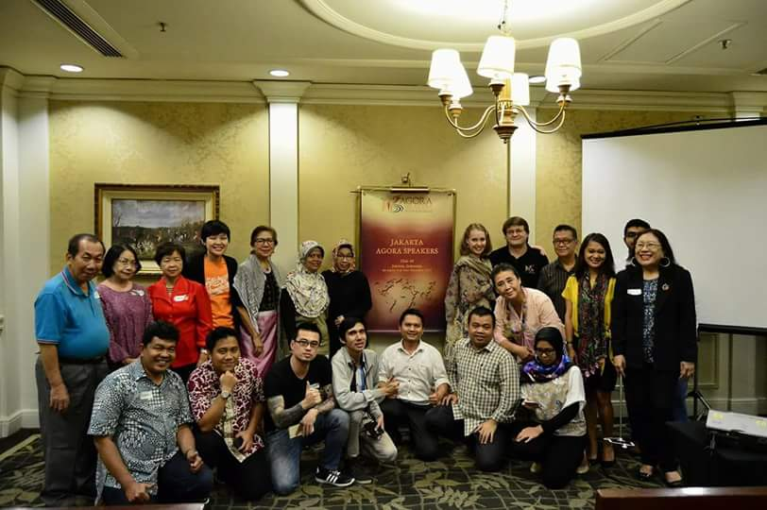
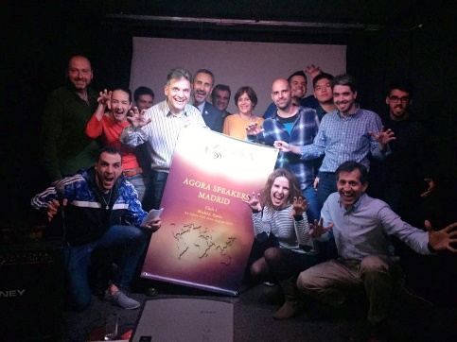
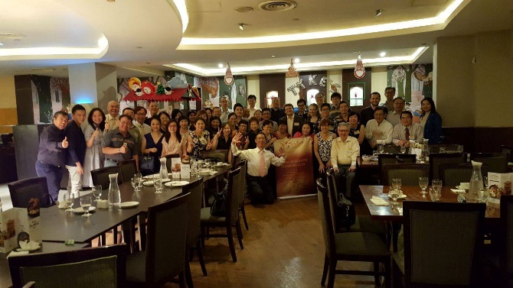
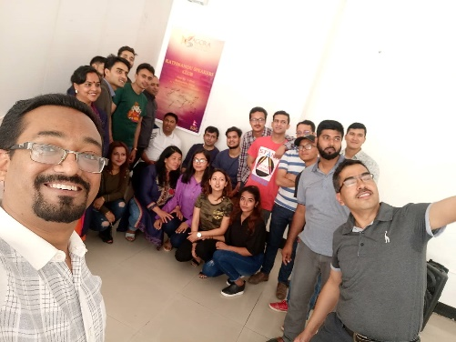
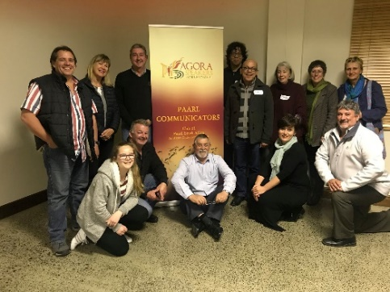
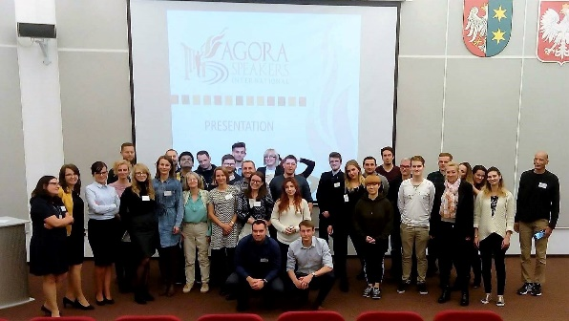
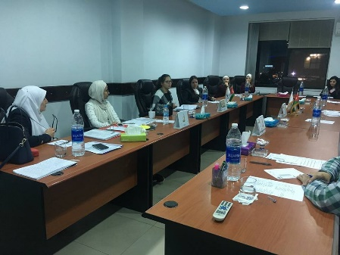
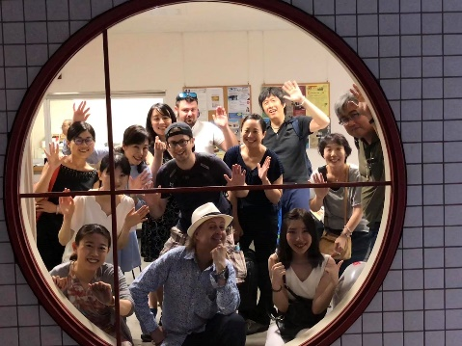
AGORA AROUND THE WORLD

Slide 43
OUR CHANNELS
www.agoraspeakers.org
wiki.agoraspeakers.org
chat.agoraspeakers.org
Worldwide community chat with per-country channels
International Group https://www.facebook.com/groups/agoraspeakers
(Only for general-interest issues not related to a specific country)
Per-Country groups
/groups/agoraspeakers.<country>/ e.g.: /groups/agoraspeakers.ghana/
@agoraspeakers
Agora Speakers
/c/AgoraSpeakers
agoraspeakers

Slide 44
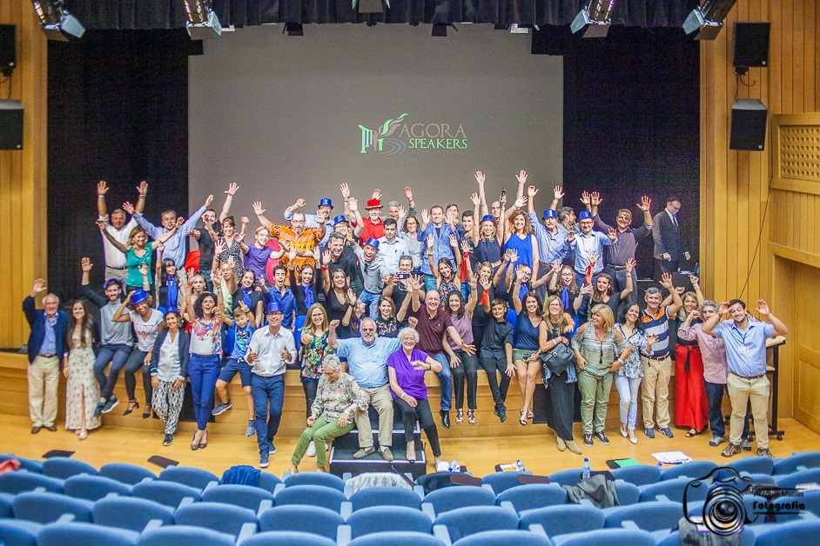
REGIONAL AND INTERNATIONAL CONVENTIONS
Each year we celebrate Regional and International Conventions for learning and sharing.

Slide 45
INTERNATIONAL CONVENTIONS
Our next International Convention is set for Sept 18-20th, Kathmandu, Nepal

Slide 46
CONTESTS
Each year we hold a Worldwide Championship for finding the best educators, speakers, and leaders, and celebrate their achievements.

Slide 47
WHAT NOW?
You can join a club or
You can start a club

Slide 48
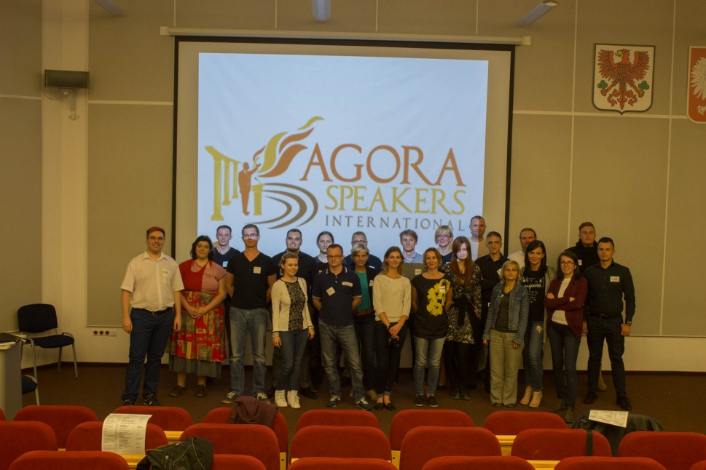
JOINING A CLUB
Check the global page http://wiki.agoraspeakers.org/worldwide to see if there is a local group for your country.
Join the local group and see which clubs are available.
Attend one of their meetings as a guest.
Ask to join!
You can join as many clubs as you want, as long as you’re able to participate regularly in their meetings.
“Club membership is subject to acceptance by the club. Even if you're a member of Agora Speakers, a club is allowed to refuse your membership in it for objective, nondiscriminatory reasons”

Slide 49
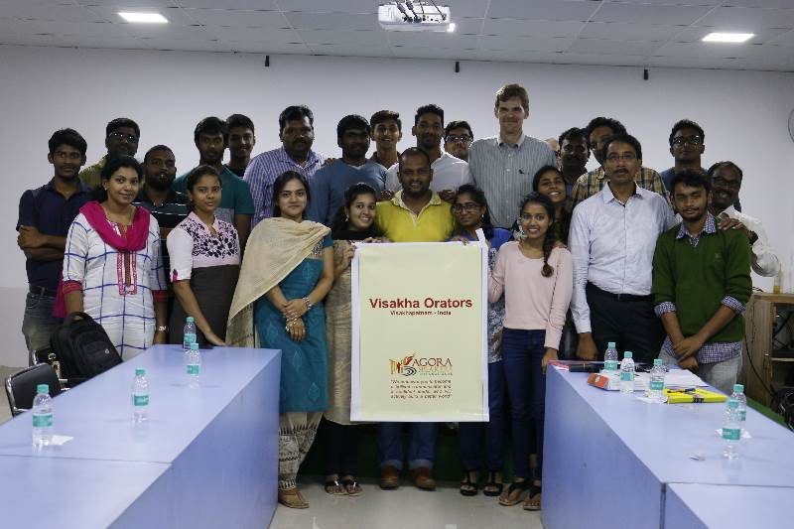
STARTING A CLUB
You can also start a club, or even become an Ambassador of Agora for your country.
Starting a club is an exceptionally gratifying endeavor:
It will teach you a lot about leadership.
You will be creating a lasting and positive impact on the lives of many people.
You will be part of a vibrant and very passionate community. Some of the people you will meet and lead might turn into professional contacts, some into close friends.
As Agora Speakers is relatively new, you will be probably creating history in your city or country and will be recognized as the one that started it there.

Slide 50
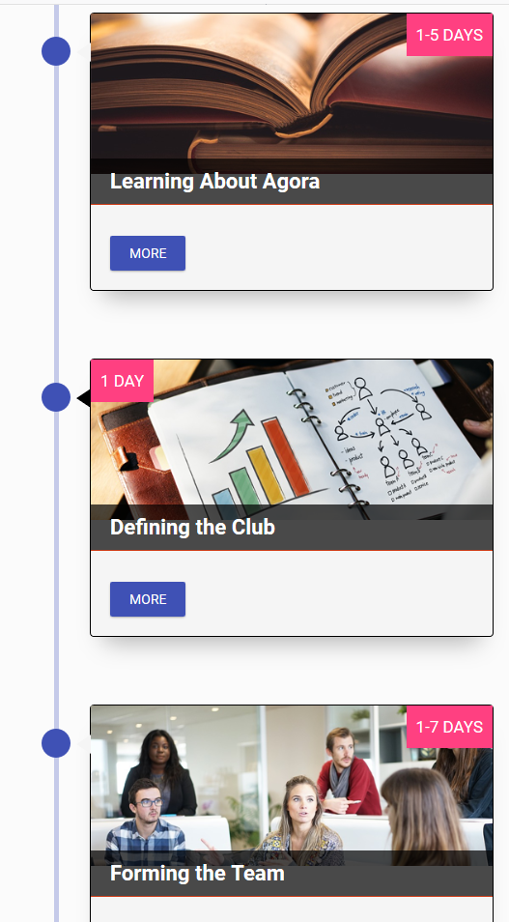
STARTING A CLUB
To start a club, you only need:
A bit of time and energy.
At least 8 more people interested to meet regularly. (This is usually easily achievable as there’s a lot of demand for this kind of learning)
A meeting venue.
If you don’t have experience with any other public speaking clubs or organizations, a bit of online training which we will provide.
This Step by Step guide provides detailed instructions
on the process of club creation and registration:
https://wiki.agoraspeakers.org/Starting+a+new+club

Slide 51
STARTING A CLUB
WE CAN HELP WITH:
Educational materials.
Templates, logos, banner and stationery designs.
You can produce all the materials locally. No need to buy stuff from a central location.
Advice and tips from people that have gone down that path, including meeting venue suggestions.
Formal backing.
Targeted promotion of your club or event, if it is the first club in your city.
WE CANNOT HELP WITH:
Funds (since we don’t charge anything either)
Free physical goods of any kind.
Compliance with the local regulations.
Insurance, if required.
Finding a meeting venue, or negotiations with local venue owners.

Slide 52
NEED MORE INFORMATION?
Download The Agora Guide, which explains all the topics in this presentation with much greater detail: http://www.agoraspeakers.org/docs/Agora_Guide.pdf
Drop us a note at info@agoraspeakers.org
Join our official Facebook group and send us a message: http://www.facebook.com/groups/agoraspeakers/

